Slide 1
Testing Web Application Functionality
Website: https://www.onlineshopdemo.co.uk/
By
Akhil Janapatla

Slide 2

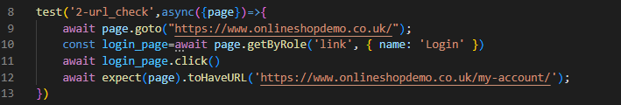



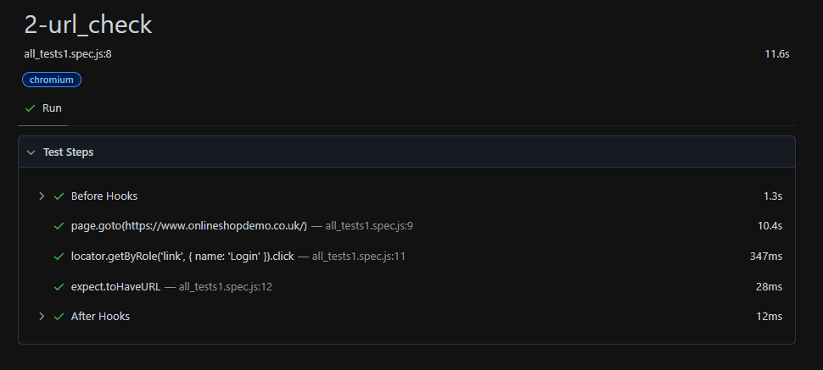
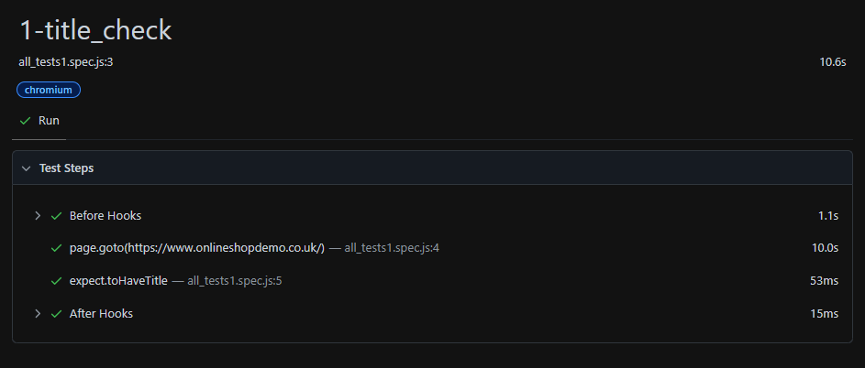
Test Case - 1: title_check
Description: Verify the page title of the home page.
Test Case - 2: url_check
Description: Validate URL after clicking the 'Login' link.

Slide 3
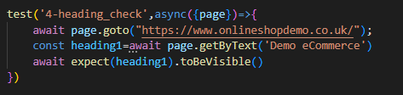
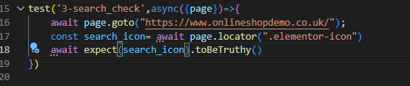
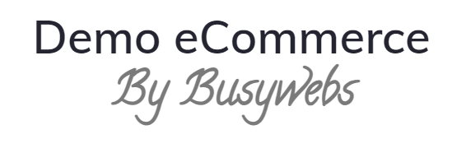

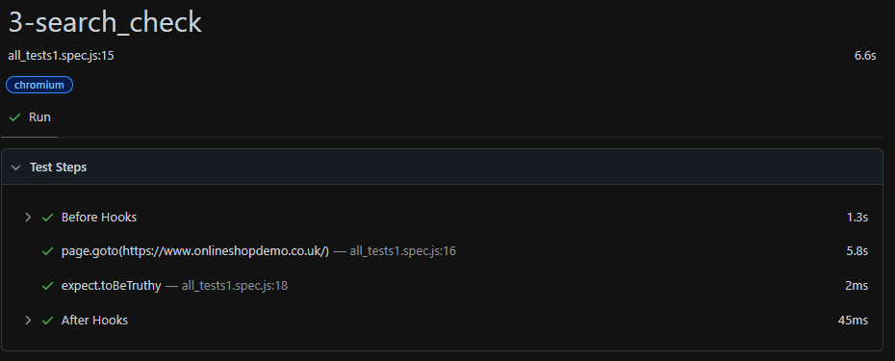
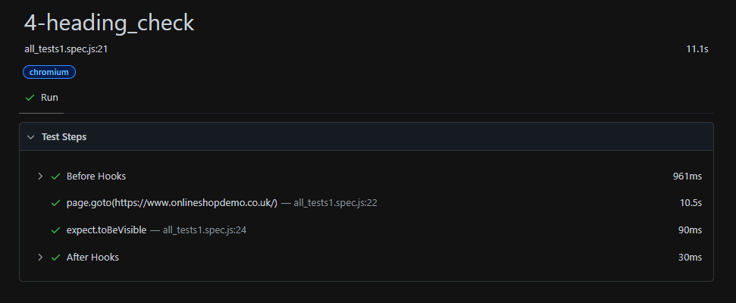
Test Case: search_check
Description: Check for the presence of the search icon
Test Case: heading_check
Description: Validate visibility of the heading in the webpage.

Slide 4
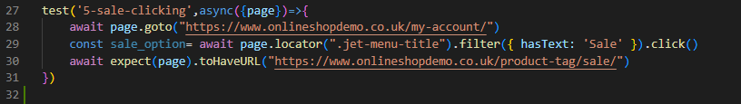

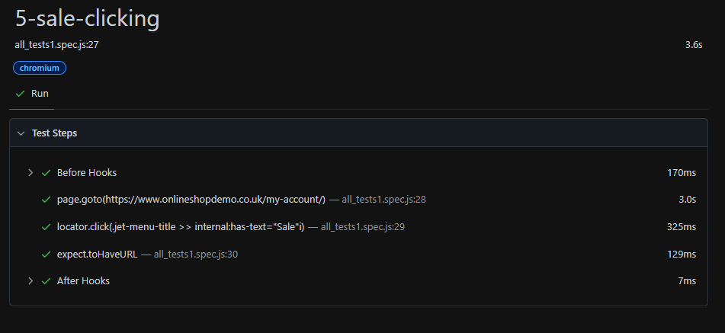
Test Case: sale-clicking
Description: Verifying navigation to the 'Sale’ webpage.

Slide 5
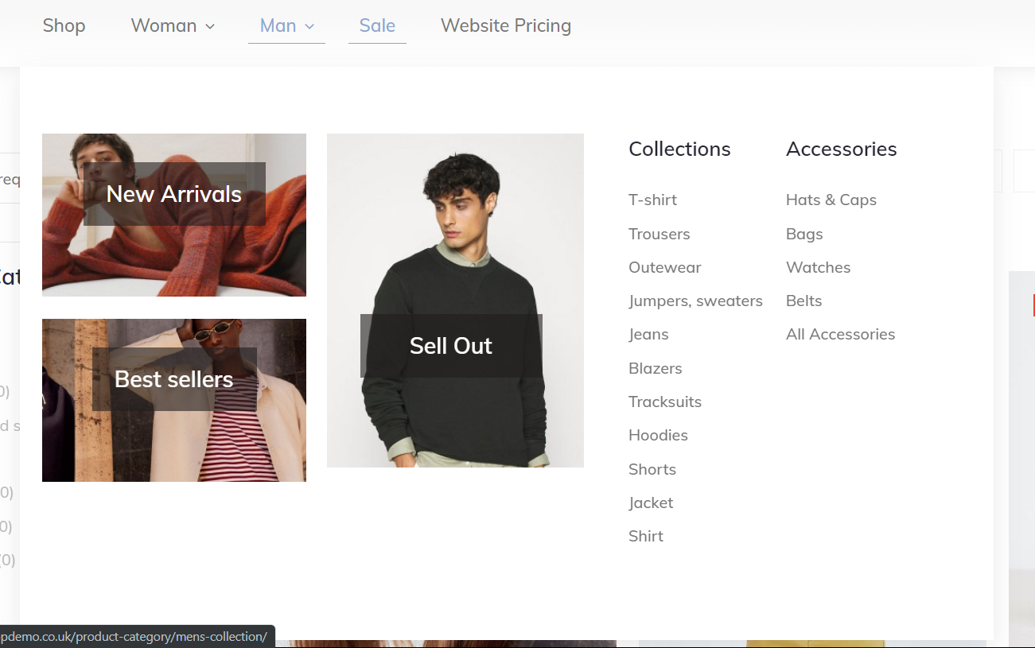
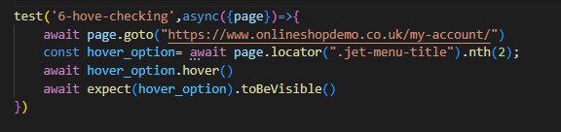
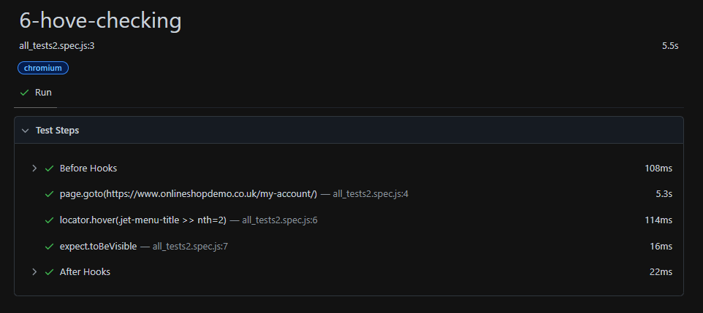
Test Case: Hover functionality check
Description: checking if hover functionality is working or not

Slide 6
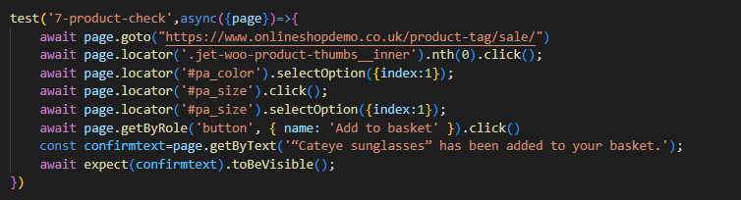
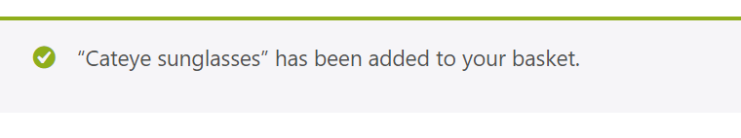
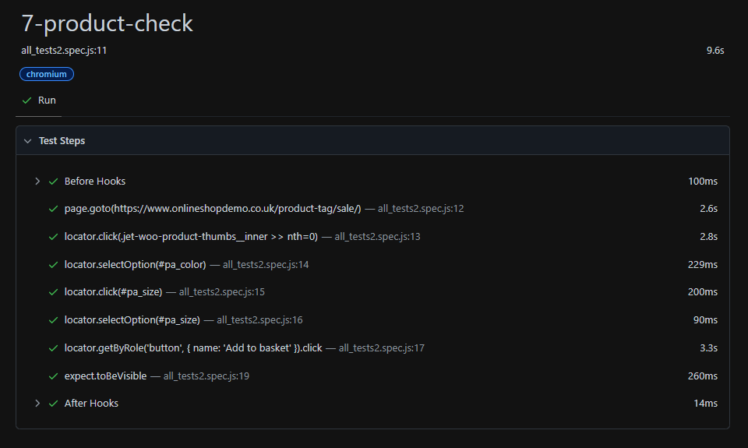
Test Case: Add to cart product Description: Add a product to the basket and verify the confirmation message.

Slide 7
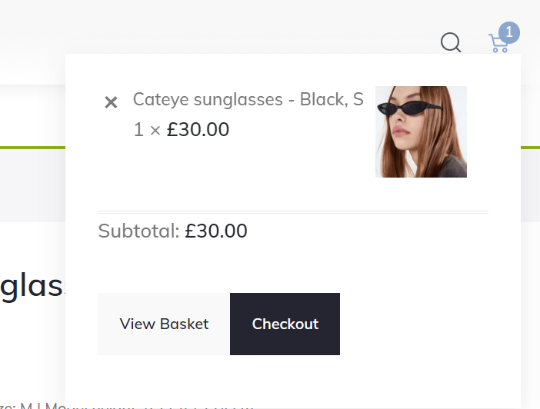
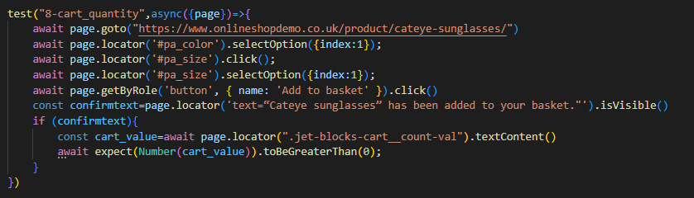
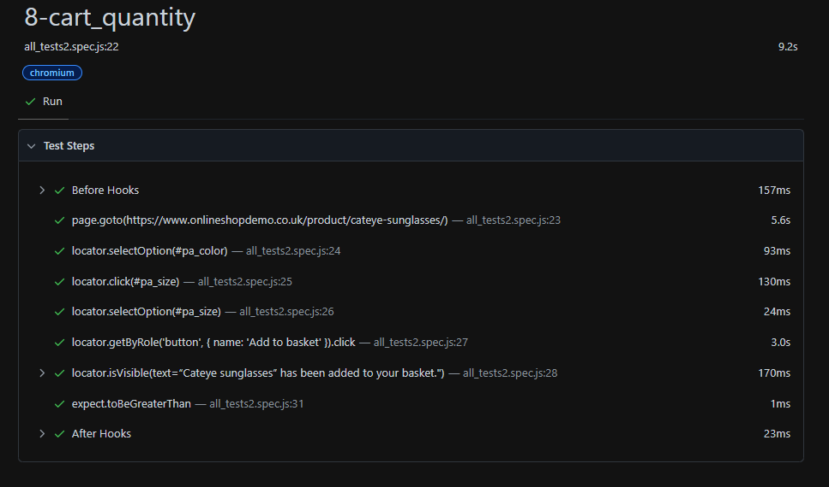
Test Case: cart quantity Description: Add a product to the basket and verify the confirmation message. Check the cart quantity after adding a product..

Slide 8
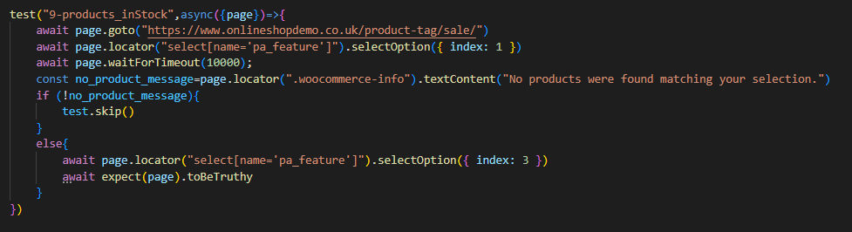
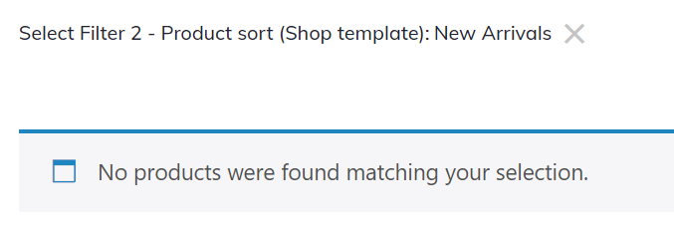
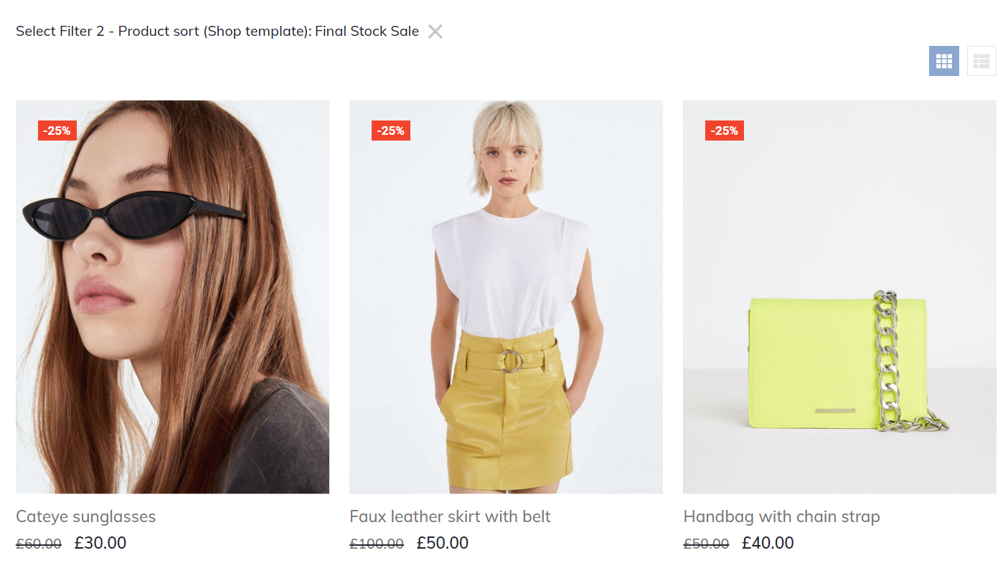
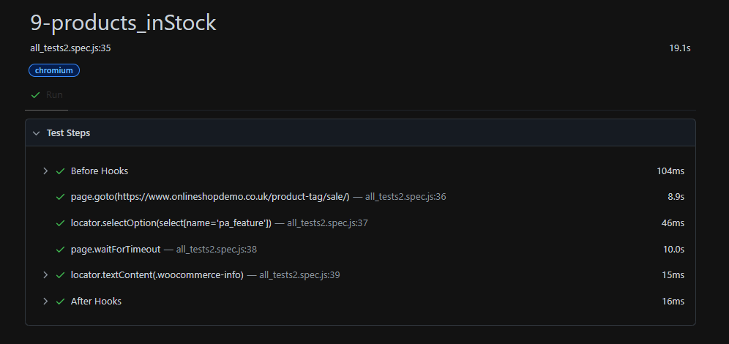
Test Cases: applying filters Description: Verify product ratings and handle scenarios where no results are found.

Slide 9
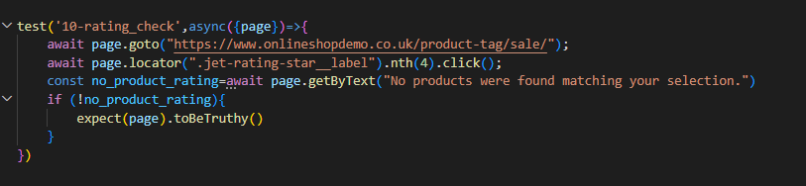
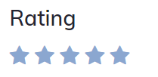
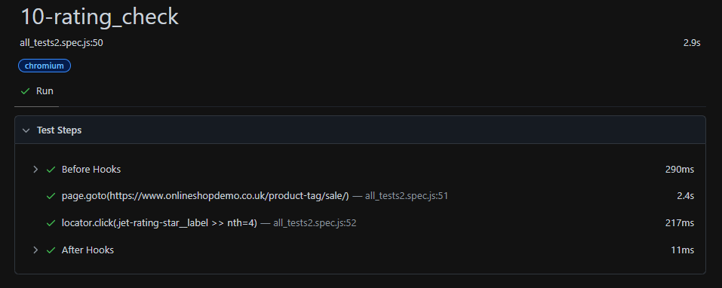
Test Case: Rating_check
Description: Check product rating and handle no results.

Slide 10
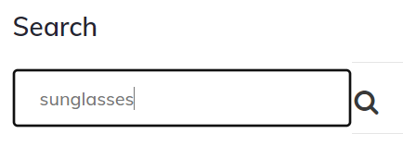
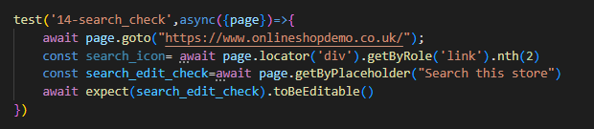
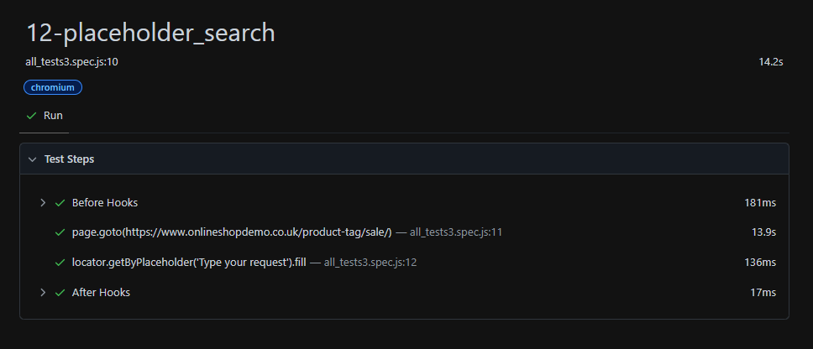
Test Case: Editable search bar check Description: check if search bar is editable or not

Slide 11
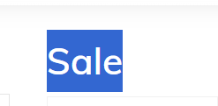
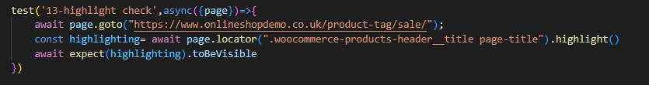
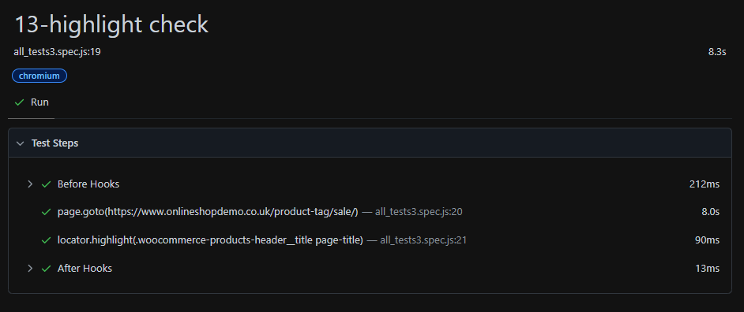
Test Case: Highlighting the text Description: check if the text is highlighting or not

Slide 12
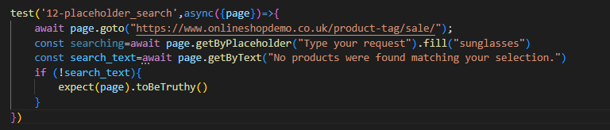
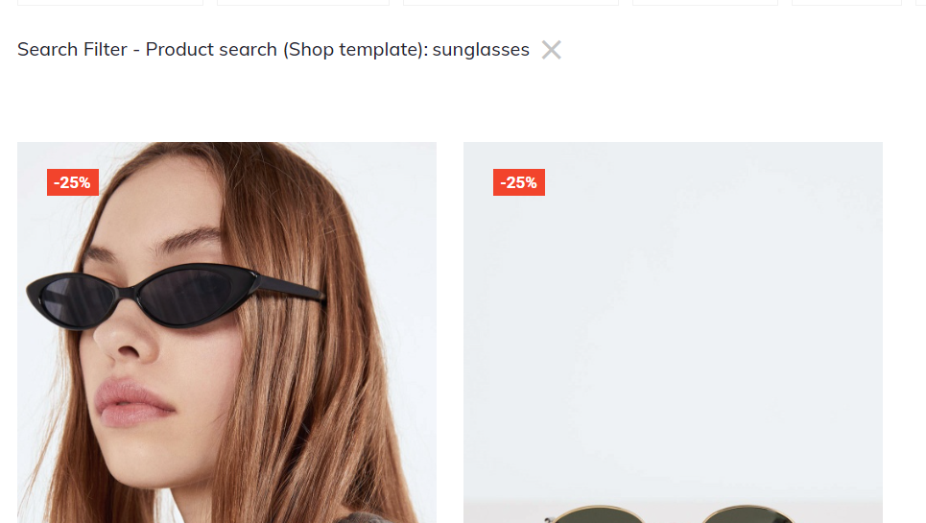
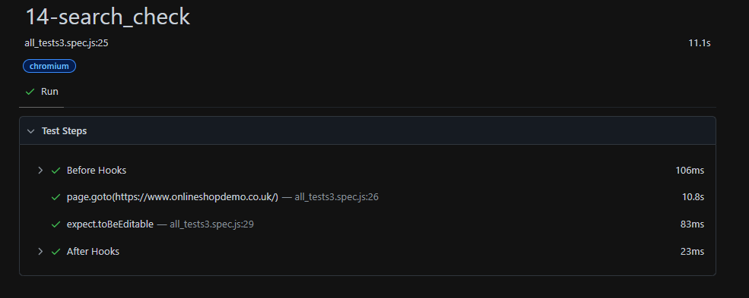
Test Case: search for results Description: checks if the products filter is filtering and produce the results

Slide 13
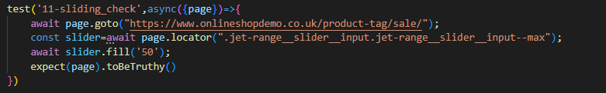

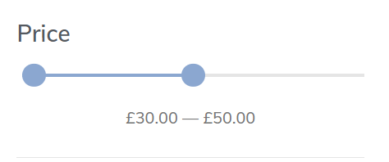
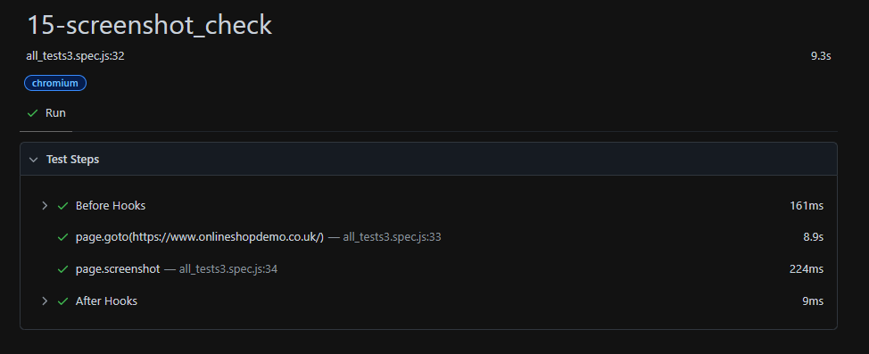
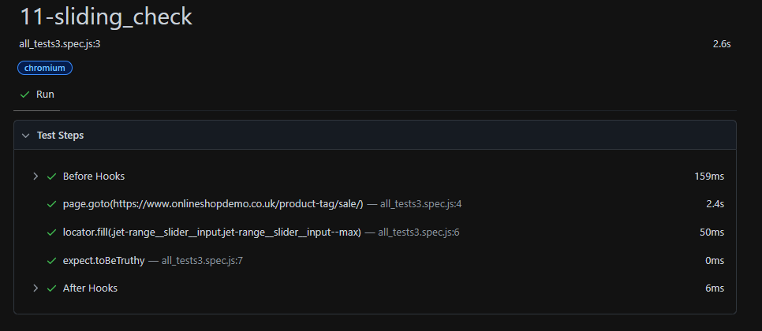
Test Case: Price range filter check Description: checks if the sliding filter works and produce the products that available Test Case: 15-screenshot_check Description: Capture a screenshot of the home page.

Slide 14
Thank you

